Slide 1


What is CSS?
CSS stands for Cascading Style Sheets
It describes how HTML elements are displayed on screen
Enables styling, layout, animations, and responsive design
Essential for creating attractive user interfaces

Slide 2
Basic CSS Selectors
element → div, p, h1, etc.
.class → .container, .button
#id → #main-header
* → universal selector
element element → descendant (e.g., div p)
element > element → direct child (e.g., ul > li)
:hover, :first-child, :nth-child(n) → pseudo-classes

Slide 3
Common CSS Properties
🖍 Colors
color, background-color, opacity
🔤 Typography
font-size, font-family, font-weight, text-transform, line-height
📦 Spacing
margin, padding, gap
🟫 Borders & Shadow
border, border-radius, box-shadow
📐 Alignment
text-align, vertical-align, justify-content, align-items

Slide 4
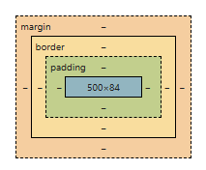
The Box Model
Content – the actual text or image
Padding – space between content and border
Border – the outline around the element
Margin – space outside the border

Slide 5
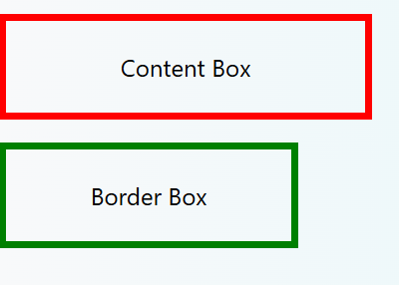
<div class="box1">Content Box</div>
<div class="box2">Border Box</div>
.box1 {
width: 200px;
padding: 20px;
border: 5px solid red;
box-sizing: content-box; /* Default */
}
.box2 {
width: 200px;
padding: 20px;
border: 5px solid green;
box-sizing: border-box; /* Recommended */
}
Best Practice * { box-sizing: border-box; }

Slide 6
difference between inline-block and block:
🧱 CSS: inline-block vs block
✅ block
Takes full width available (stretches to the parent’s width).
Always starts on a new line.
You can set width and height.
Examples: <div>, <p>, <section>
display: block;

Slide 7
✅ inline-block
Sits inline with other elements (like text).
Respects width and height (unlike plain inline).
Doesn’t start on a new line.
Good for layout without breaking flow.
display: inline-block;

Slide 8
<div style={{display: "block", background: "lightblue"}}>Block Element</div>
<span style={{display: "inlineBlock", background: "lightgreen"}}>Inline-Block Element</span>
<span style={{display: "inlineBlock", background: "lightcoral"}}>Another Inline-Block</span>

Slide 9
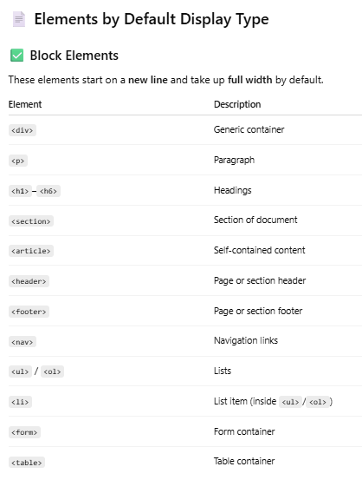

Slide 10
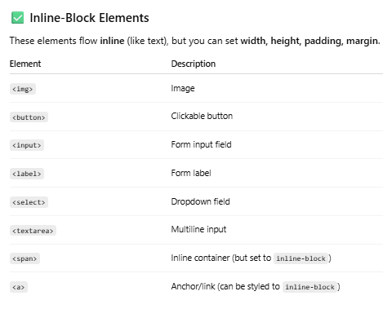
🧪 Example of changing display:
a {
display: inline-block;
padding: 10px;
background: lightblue;
}

